Slide 1

helpmewithmymood
With social–media health analysis and display engine(SHADE)

Slide 2
Contents:-
Services and Technology Used
Problem description
Our idea
Outputs
Business value derived outcome of work in simple terms

Slide 3
Services-used:
IBM Watson Tone Analyser.
Twitter API
Technology Used
Python 3

Slide 4
1.Develop a mobile/desktop app that will Get a person’s social contents (e.g. tweets) for a duration (e.g.past24 hours). 2.Perform sentiment analysis using IBM Watson on the above content. 3. Display the person name and his/her most prominent sentiment. 4.Suggest measures to soothe or calm down the mood of the person by suggesting some curated playlist of songs based on his interest or something similar.
EXPECTATIONS:

Slide 5
OUR idea:
Ask the user to enter the twitter screen name.
Retrieve data from twitter API .
Fetch last 30 tweets.
Clean fetched data i.e. removal of emoji’s and URL's using ‘re’ and ‘emoji’ modules of python3.
Tone analysis using IBM Watson tone analyser on the cleaned data.
Fetch the prominent emotion/sentiment from sentence level analysis.
Use this emotion to work accordingly.
Display the window showing the person screen name and his/her mood.
YouTube music playlist in the default web browser of the user.

Slide 6
OUTPUTS:

Slide 7
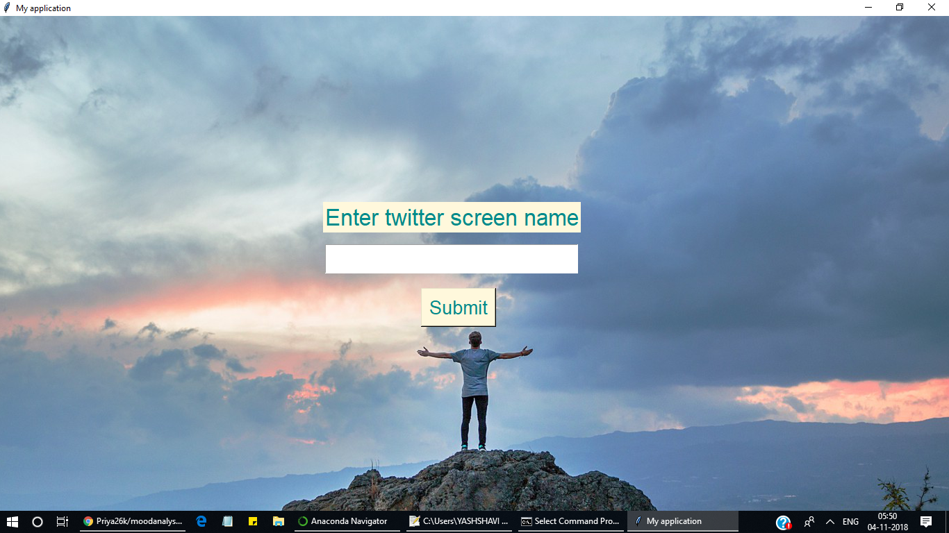
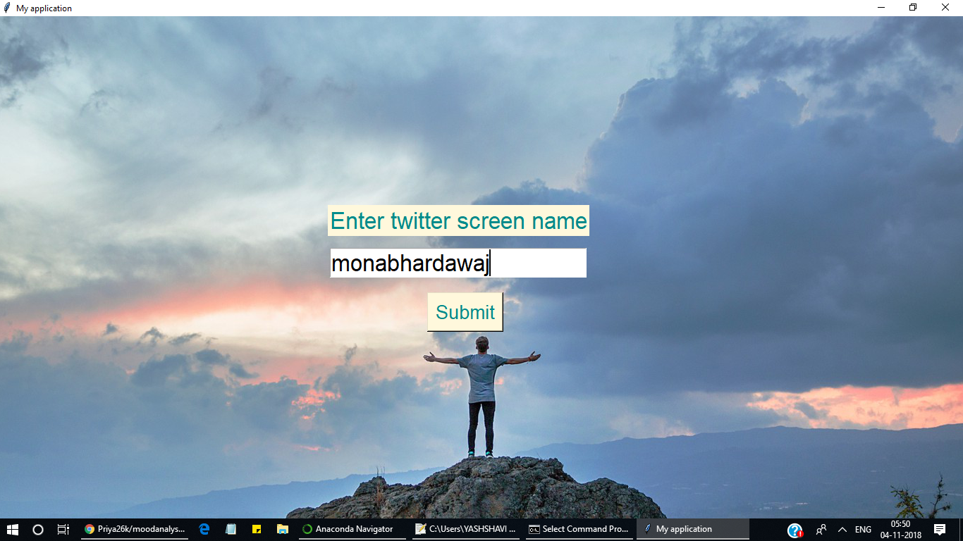
First window : where the user will be asked to enter the twitter screen name to know the sentiments of the person

Slide 8
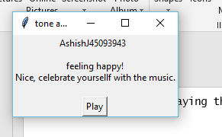
SECOND WINDOW :
Displaying the mood by analysing using submitted screen name.

Slide 9
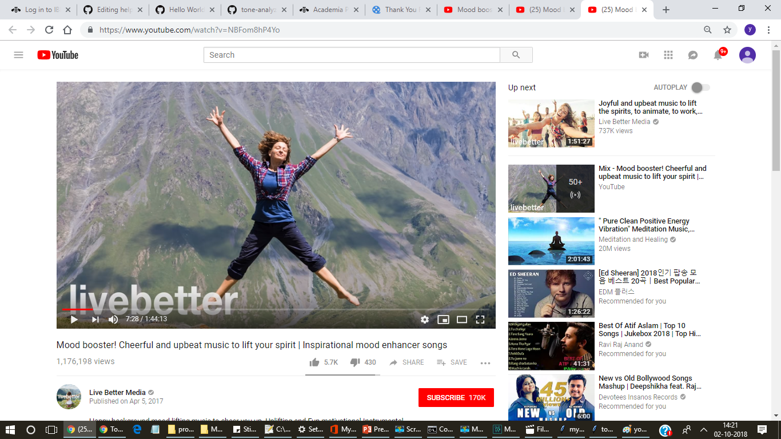
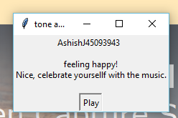
Video played after suggestion(as user click on the suggested play button

Slide 10
Business value derived-outcome of work in simple terms.:
Beside the lifesaving purpose, the app can also be used for business.
Customer caring franchises to improve their service quality and hence to increase the market value.
Restaurants to know the most prominent mood of the most customers and can play the curated playlist of songs accordingly.
Airline services, railways.

Slide 11


Thank You
Priya Khandelwal
Yashshavi kashyap
yashshavikashyap@gmail.com

